Slide 1
Building A Multimodal Retrieval Augmented Generation (MM-RAG): A general purpose tool for combining Text and Images in Unique and Engaging Manner
Maryam Bandali, Leelavathi Chandrappa, Lumi Nariyama Hofstad, Ricky Stanley D’Cruze
Group 4, VT24
DM2586 - Generative AI for Media Technology and Interaction Design Course, KTH
March 2024

Slide 2
Table of Content
Introduction
Background
Methodology
Result
Discussion
Conclusion

Slide 3
Introduction
In recent years, Generative AI systems have demonstrated their capabilities to generate accurate and relevant content
Challenges: With the continuous expansion of network sizes, models frequently struggle to encode rare or infrequent information.
Objective: Our project aims to tackle these challenges by developing MM-RAG, a system that integrates text, images.

Slide 4
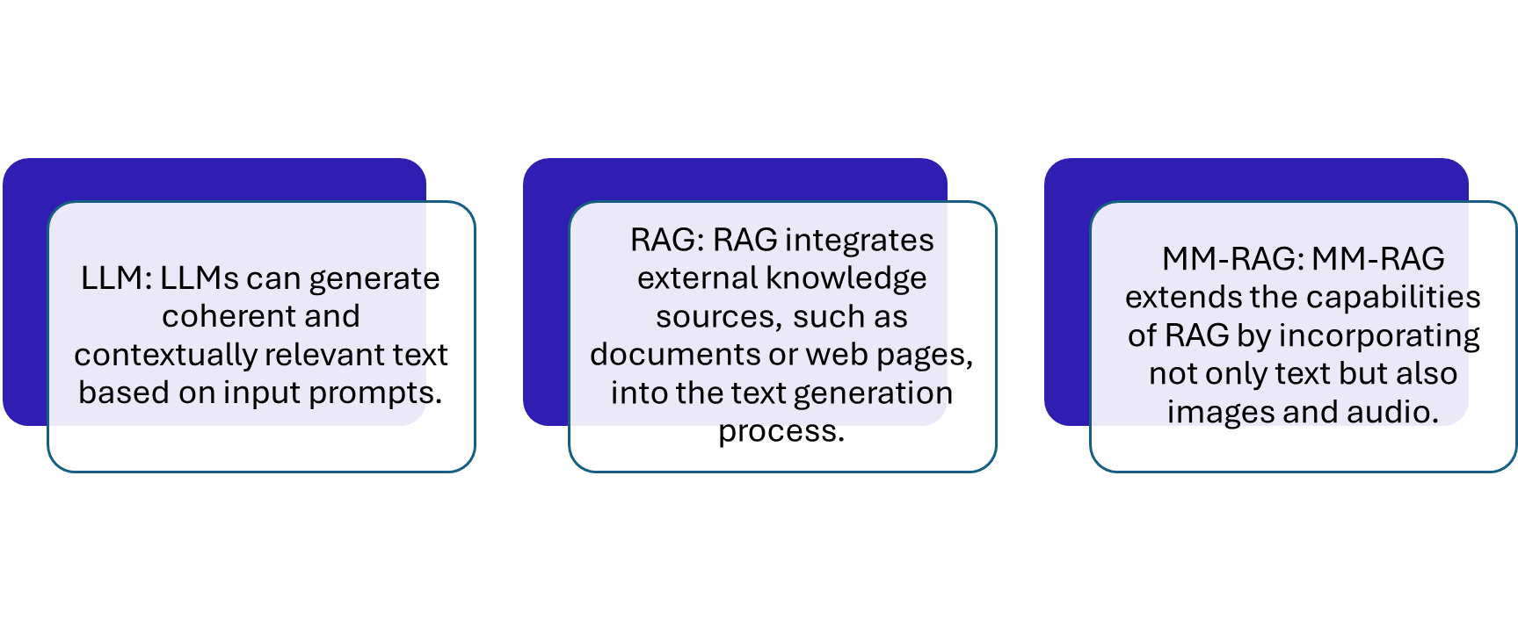
Introduction: Content Generation Techniques

Slide 5
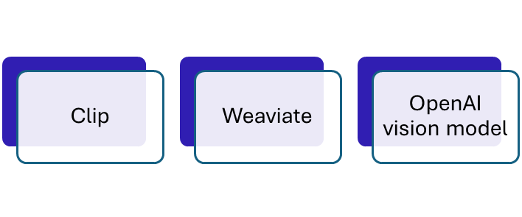
MM-RAG: Enriching Content with Images and Text
The objective of the project is to develop Multimodal Retrieval Augmented Generation (MM-RAG), by combining the capabilities of CLIP, Weaviate and the OpenAI vision model.

Slide 6
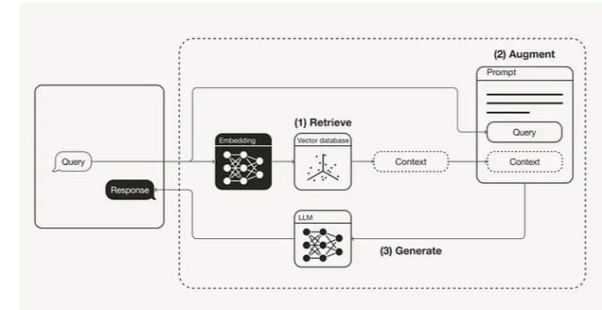
Background: RAG & MM RAG
Leonie Monigatti. Retrieval-Augmented Generation (RAG): From Theory to LangChain Implementation. https://towardsdatascience.com, 2023.

Slide 7
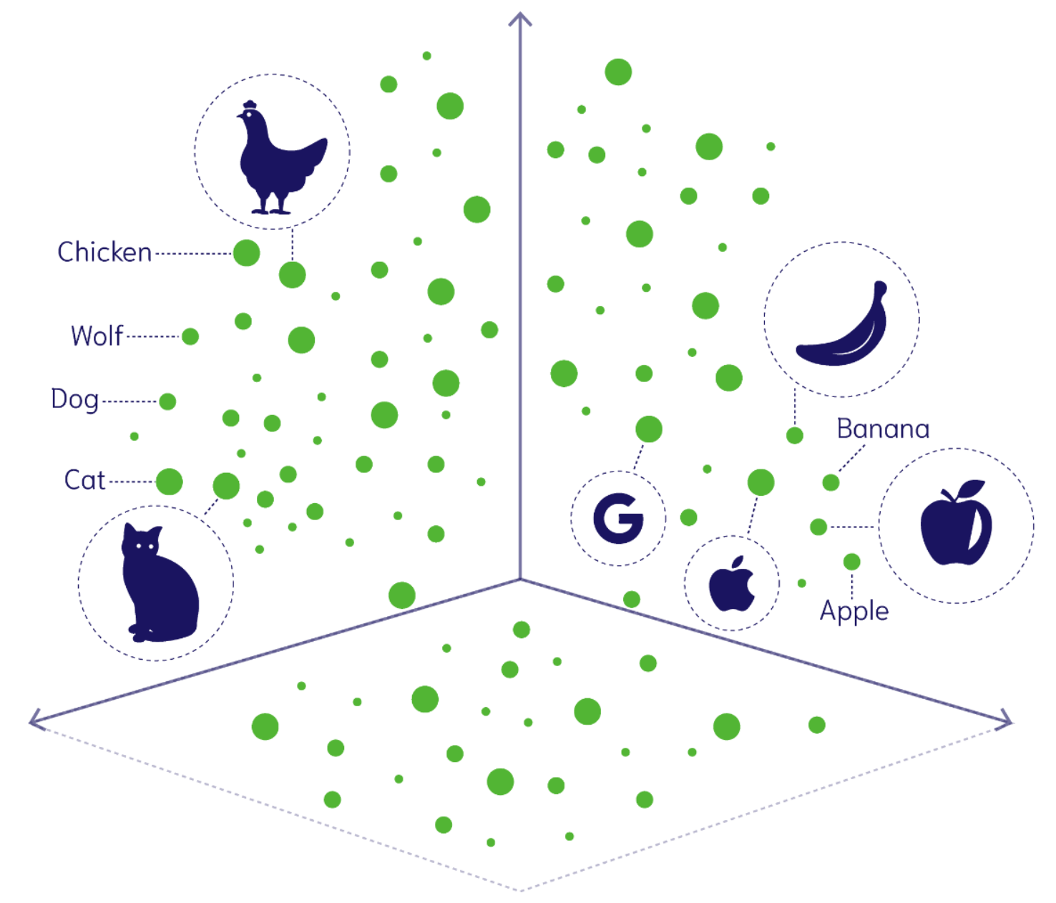
Background: Vector Embedding
Weaviate: A Vector Data Base
CLIP: A Neural Network Model for Converting Images to Vector Embeddings
Weaviate, B.V. Built with Docusaurus. Weaviate Official Documentation. https://weaviate.io, 2023.

Slide 8
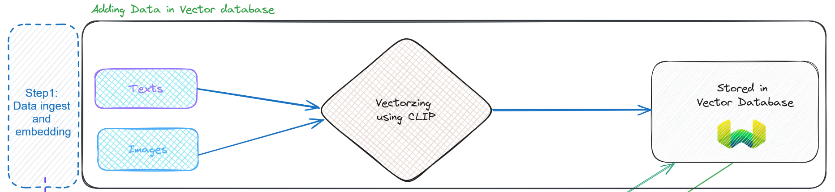
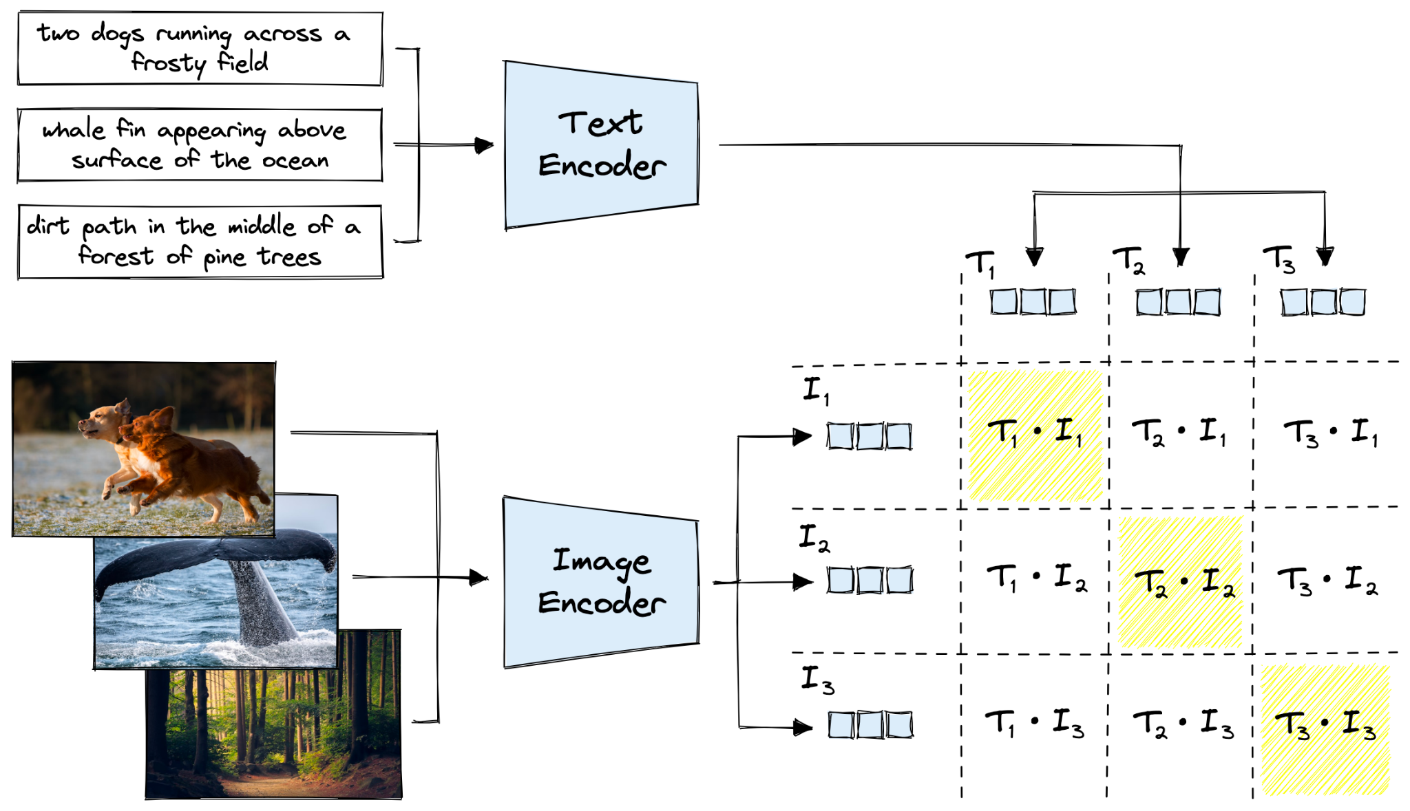
Methodology
sentence-transformers/clip-ViT-B-32-multilingual-v1
Notes:
https://huggingface.co/sentence-transformers/clip-ViT-B-32-multilingual-v1
This is a multi-lingual version of the OpenAI CLIP-ViT-B32 model. You can map text (in 50+ languages) and images to a common dense vector space such that images and the matching texts are close. This model can be used for image search (users search through a large collection of images) and for multi-lingual zero-shot image classification (image labels are defined as text).
Hierarchical Navigable Small World (HNSW): index (default) is a more complex index that is slower to build, but it scales well to large datasets as queries have a logarithmic time complexity.

Slide 9
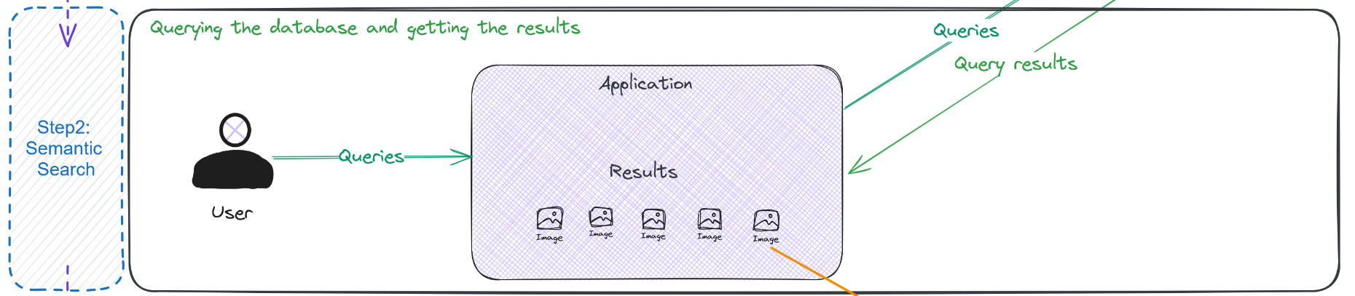
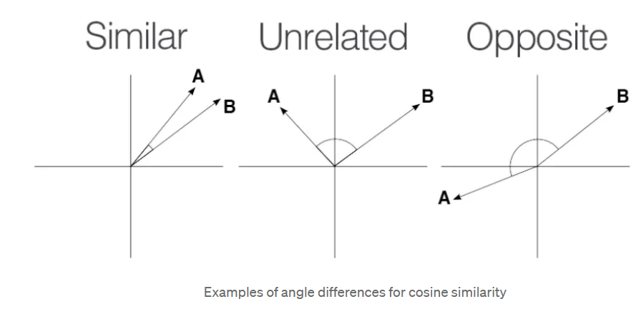
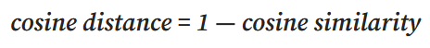
Methodology
Notes:
User queries using plain text or image.
And application shows the best 6 images with the closest cosine distance.
The cosine distance ranges from 0 to 2, with a value of 0 denoting identical vectors, 1 indicating no correlation, and 2 representing complete dissimilarity.

Slide 10
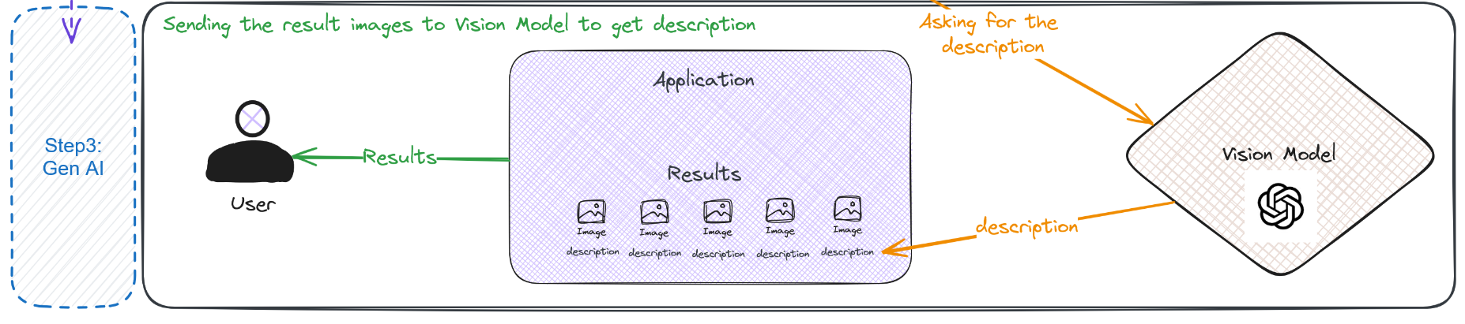
Methodology

Slide 11
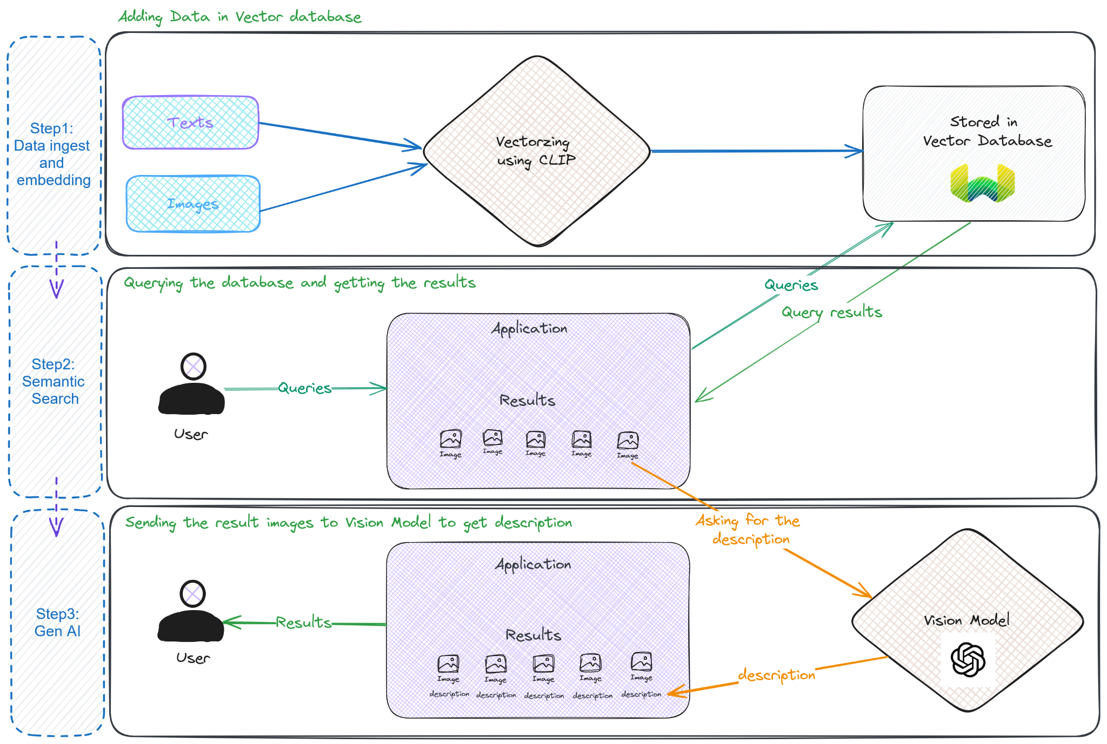
Methodology

Slide 12
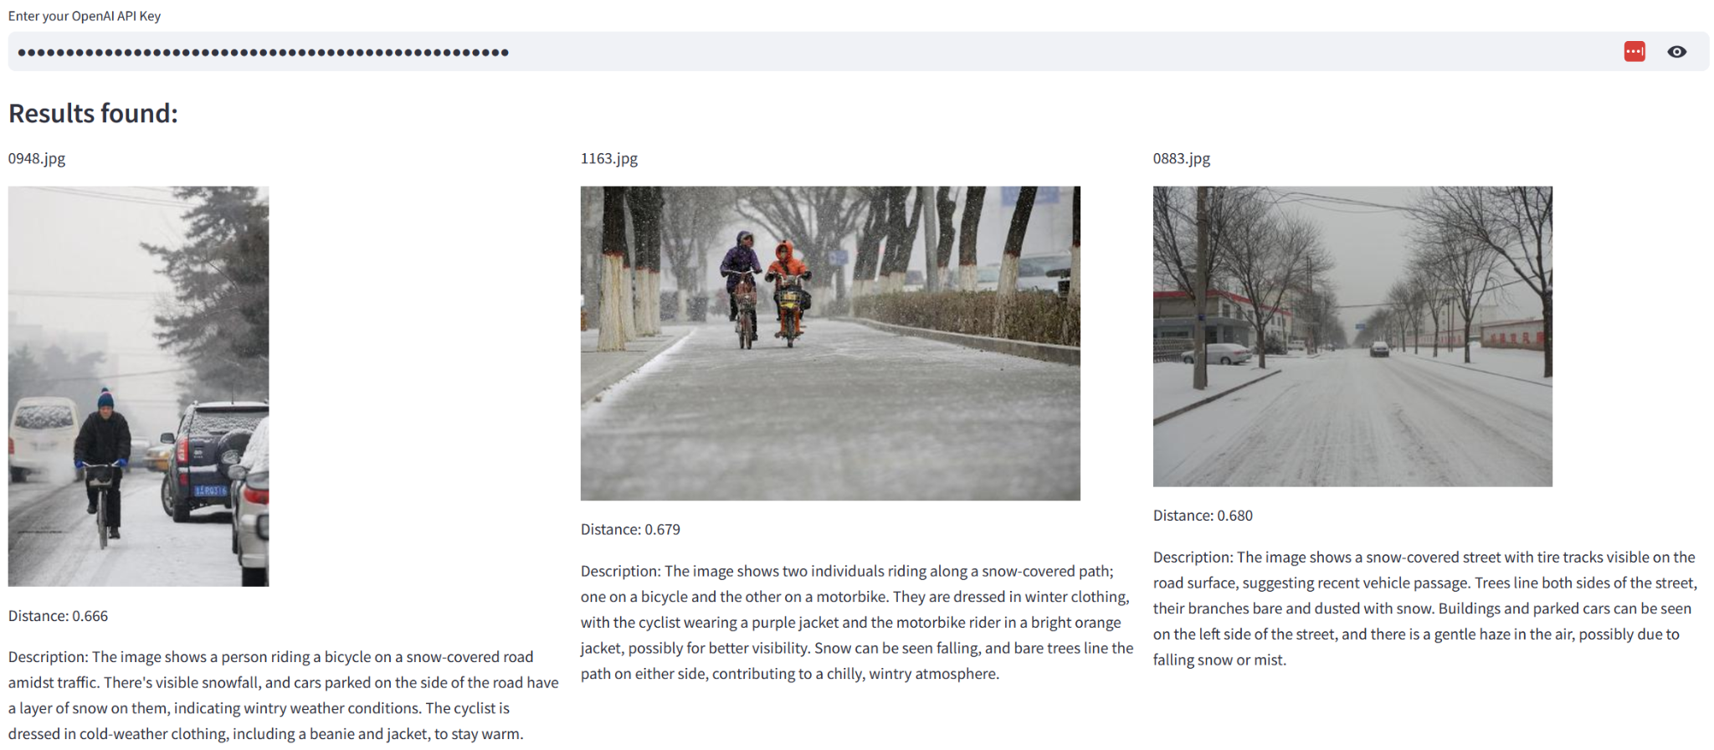
Result
Search text query: “snowy road during the winter where people are cycling”

Slide 13
Discussions
CLIP ViT model : It doesn’t do good in spotting things in the picture. As it was trained from internet pictures and texts, it’s rather good in Zero-shot learning and vectoring things, so finding similarities was good enough.
Limitation of our study : We haven’t measured the accuracy of the description provided from the Open AI Vision model. In future, we would like to investigate it more and in details and even other open source vision models.
Notes:
We used the OPEN AIs vision model, CLIP ViT. It performs so well in zero-shot learning and finding similarities. But it struggles with identifying objects in pictures due to its training on internet images and texts.
To make CLIP ViT better at tasks we have seen in the result, more research is needed to figure out how to improve its abilities when it hasn’t been trained for a specific task.
As a study limitation, we didn't assess the accuracy of descriptions from the OpenAI Vision model. So, we would like to delve deeper into this and explore other vision models.

Slide 14
Conclusion
We utilized existing models and technology to build our application and saw MM-RAGs potential in multimodal content synthesis and its ability of adaptation.
Future study direction :
Finding ways to tailor our model within different domains by researching MM-RAGs capability of adaptation and utilization.
Necessity of further study to do systematic evaluation of the system e.g. user study, rating frameworks we have used for our project.
Notes:
-> For this project we used the existing models and technology to build an application. (As we mentioned,) In our case texts and images are used as a multimodal data to solve problems.
and we could see that the process of multimodal RAG helps optimize the output of LLMs.
(future study direction)
Multimodal RAG is still a new approach and its potential is enormous. Our application is right now used for general purpose, but of course its functionality could be extended/ or adjusted according to what users need.
-> again as we mentioned in the discussion, we couldn’t measure the accuracy of the description.
In the future, we would like to evaluate the system including evaluation of frameworks and do user study to improve the application.
-> For this project we used the existing models and technology to build an application. (As we mentioned,) In our case texts and images are used as a multimodal data to solve problems.
and we could see that the process of multimodal RAG helps optimize the output of LLMs. It helps users to get reasonable answers from that additional information.
(future study direction)
Multimodal RAG is still a new approach and its potential is enormous. Our application is right now used for general purpose, but of course its functionality could be extended/ or adjusted according to what users need.
-> again as we mentioned in the discussion, we couldn’t measure the accuracy of the description.
It is necessary to evaluate the system including evaluation of frameworks and user study to build a system and see its performance and then improve it.
So, this would be our future study direction to create a better application with a better approach.

Slide 15
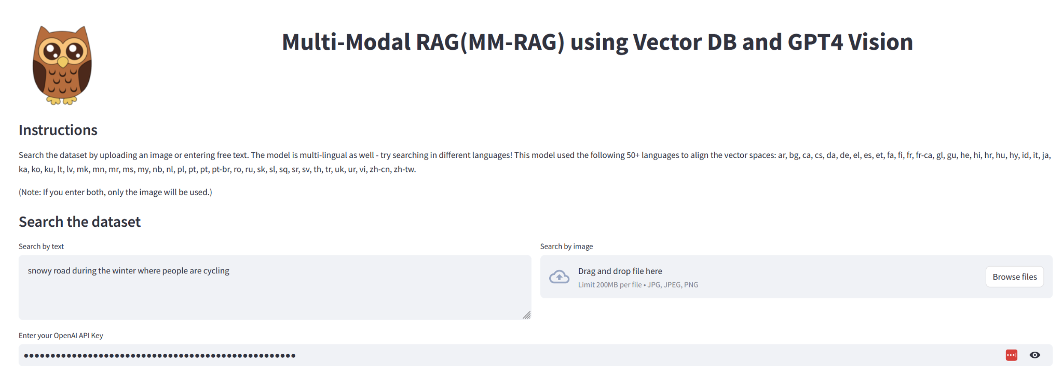
Demo

Slide 16
Thank you!
Any Questions?

